Slide 1
PYTHON FOR DATA SCIENCE
Based on Introduction to Python for Data Science
https://www.edx.org/course/introduction-to-python-for-data-science-3

Slide 2

What can you do with Python? Video: Ecourse Review
Notes:
Video: https://www.youtube.com/watch?v=hxGB7LU4i1I

Slide 3
References
edX course: Introduction to Python for Data Science, https://www.edx.org/course/introduction-to-python-for-data-science-3
Swaroop, H. (2013). A Byte of Python.
Python documentation: https://docs.python.org/3/index.html
Python cheat sheets

Slide 4
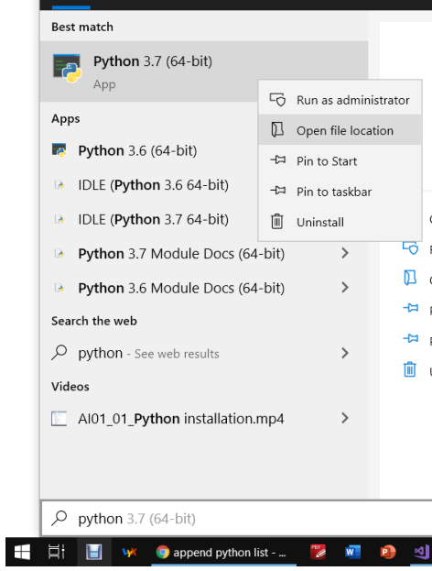





To find script Python folder:
pip3.6 install numpy

Slide 5


Slide 6




Slide 7












Slide 8



Slide 9



import math;
math.sqrt();

Slide 10





Slide 11


import math;
math.sqrt()
math.pow()

Slide 12
numpy array vs python list
# python list
list01 = ['UTE', 10, 2020, 'April']
print(list01)
print(type(list01[0]), type(list01[1]))
# numpy array
np_array01 = np.array(['UTE', 10, 2020, 'April'])
print(np_array01)
print(type(np_array01[0]), type(np_array01[1]))
# Store ONE type
# python list
heights = [1.7, 1.65, 1.8, 1.6, 1.75]
weights = [65, 55, 63, 51, 70]
bmi = []
for i in range(0,len(heights)):
bmi.append(weights[i]/heights[i]**2)
print(np.round(bmi,2))
# numpy array
height_array = np.array([1.7, 1.65, 1.8, 1.6, 1.75])
weight_array = np.array([65, 55, 63, 51, 70])
bmi_array = weight_array / height_array**2
print(np.round(bmi_array,2))
# Simpler, faster

Slide 13
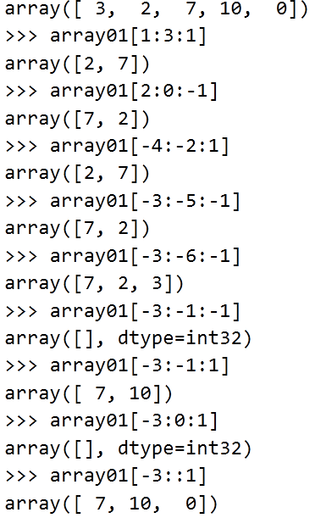
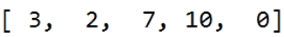
Referring to list/np array
elements (Slicing)
# Swap elements (ONLY for np array)
array01[[0,1]] = array01[[1,0]]

Slide 14
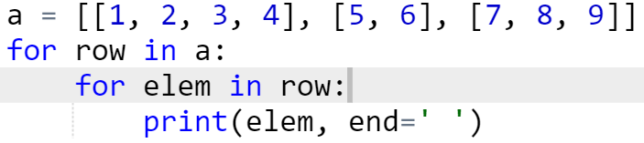
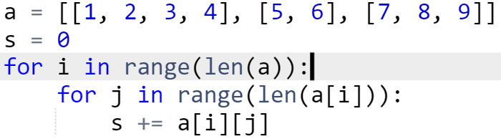

2D list/np array (Matrices)
List: can be a set of lists
Np array: a matrix
a = np.array([[1, 2, 3], [4, 5, 6]], np.int32)
a[:, [0, 2]] # slicing, get 1st and 2nd col.
For more: google 2D list python

Slide 16
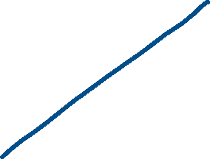



Slide 17
2D plot
import matplotlib.pyplot as plt
x = np.array([1,2,3])
y = np.array([3,2,6])
#x = np.arange(-4.0, 15.0, 0.1)
#y = 5*x**2 + 4
plt.plot(x,y, color = 'red', linewidth=2)
plt.plot(x,np.zeros(x.shape))
plt.xlabel('x')
plt.ylabel('y')
plt.title('Title')
plt.legend(['quaratic func', 'Ox'])
plt.grid()
plt.show()

Slide 18

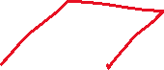
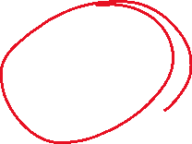

Slide 19
3D plot
import matplotlib.pyplot as plt
from mpl_toolkits.mplot3d import axes3d
from matplotlib import cm
X = np.linspace(-1, 1, 100)
Y = np.linspace(-1, 1, 100)
X, Y = np.meshgrid(X, Y)
Z = X**2 + Y**2
# Plot the surface
fig = plt.figure()
ax = fig.gca(projection='3d')
surf = ax.plot_surface(X, Y, Z,
rcount = 10, ccount = 10, # control no. of points, can interpolate points
cmap=cm.coolwarm)

Slide 20
3D plot
ax.set_xlabel('x', fontsize=10, color='red')
ax.set_ylabel('y', fontsize=10, color='red')
ax.set_zlabel('f(x,y)', fontsize=10, color='blue')
ax.set_title('Title', fontsize=10, color='black')
fig.colorbar(surf, shrink=0.5, aspect=5)
plt.show()

